Slide 1
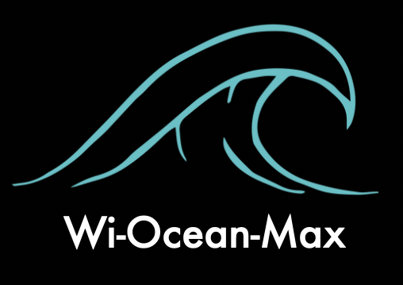
A CONNECTED WORLD
BUOY DESIGN

Slide 2
Wi-Ocean-max (W.O.M)
W.O.M or sea of points is a network system with a range of up to 50km of radio per device, this system has wimax signal transmitters that would be interconnected with each other and strategically located at sea through a mesh network to create a large area of coverage replacing the high cost of the satellite signal. Thus being one of the prototypes responsible for transmitting internet in the ocean.

Slide 3
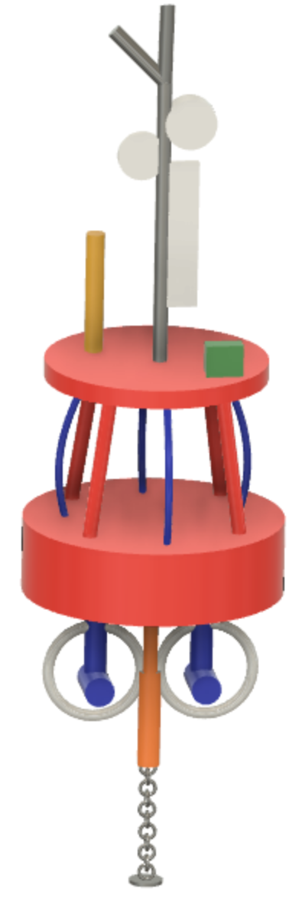
Parts of the buoy
For lightning
Signaling beacon
Signal antenna and repeaters
Wind-power generator
Bird gar
Tidal generator
Elevator
Anchor

Slide 4
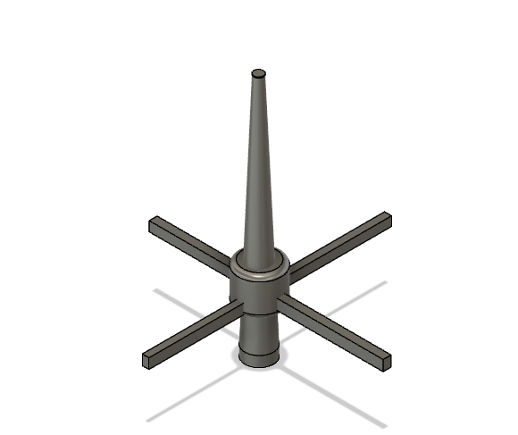
For lightning
The lightning rods are instruments, made of metallic material, which aim to attract the rays that are in the air and produced by storms, so that they can discharge on the ground.
They protect a larger radius.
They have greater durability.
They can be used under any environmental condition.
High level of protection
They do not need external power.
Easy installation.

Slide 5
Signaling beacon
It is known as a signal beacon that, whether mobile or fixed, is installed in a place to carry out a warning or with the intention of orienting vehicle traffic. The act of signaling with beacons is called beaconing, while its result is called beaconing.

Slide 6
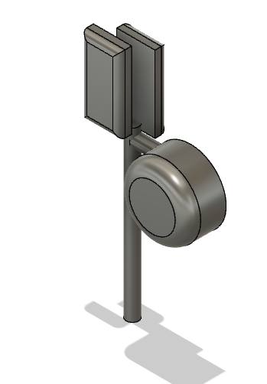
Signal antenna and repeaters
WiFi antennas offer three fundamental properties to a wireless system: gain, direction and polarization.
When the gain of a directional antenna increases, the angle of radiation usually decreases. This provides a greater coverage distance, but reduces the coverage angle. The coverage area or radiation pattern is measured in and is known as beam width.

Slide 7
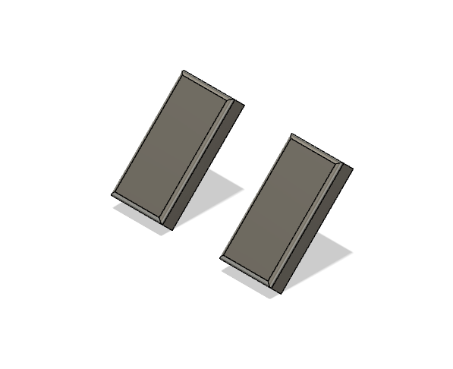
Wind-power generator
Solar panels are individual photovoltaic modules that capture the energy provided by the sun by converting it into electricity. They are formed by solar cells that in turn contain individual solar cells made of semiconductor materials such as silicon (crystalline and amorphous) that transform light (photons) into electrical energy (electrons).

Slide 8
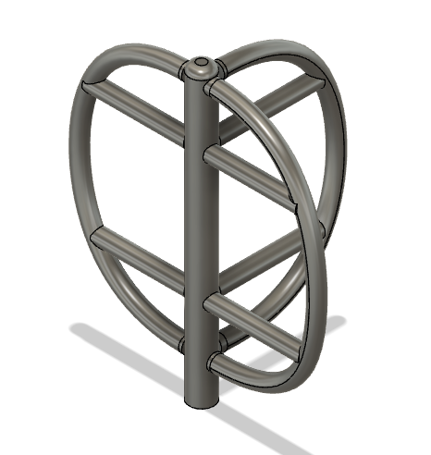
Vertical wind turbines
The objective is to simultaneously produce a drag and lift effect on the rotor at different moments of the rotation movement to obtain the maximum possible energy at different wind speeds.
Wind turbines convert part of this kinetic energy into electrical energy. In the most widespread model, the mechanical device is a fixed propeller on a horizontal rotor, installed high to take advantage of more intense and regular winds. These devices take advantage of almost 50 percent of the kinetic energy of the wind that passes through them

Slide 9
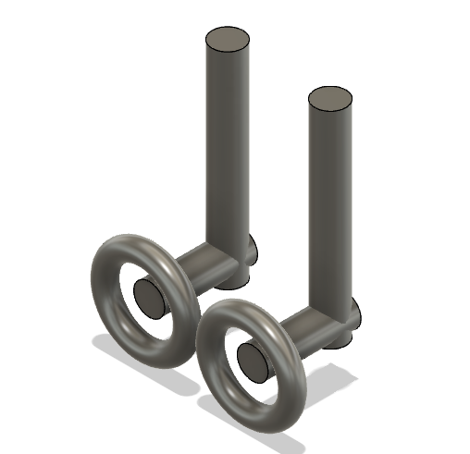
Tidal generator
The tidal energy that is obtained from the use of the tides. Through tidal plants, sea water is used in different ways to generate, through an alternator system, an electric charge that can be used in many ways.
The operation of these plants is simple: when the tide rises, the floodgates of the plant are opened and the water is allowed to enter, which will then be retained when the tide is lowered, to be released through a mechanism of turbines that will transform the Kinetic or potential energy of water in electricity.

Slide 10
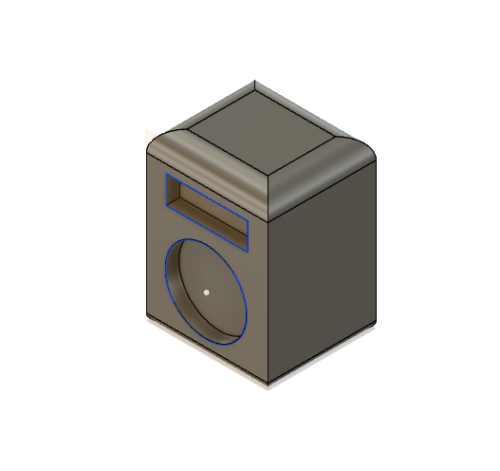
Bird repeller Bird Bard system
The Bird Bard is a system with an amplifier and a built-in speaker. It is designed with a coverage of up to 0.6 hectares. Full coverage of Bird Gard forces birds to leave the protected area. Most annoying birds communicate at the upper end of the audio spectrum (2,000-10,000 Hz).
Box Shipping dimensions: 30.5 x 17.38 x 12.7 cm
Frequency range: 2,000 - 10,000 H
Sound output: 100-105dB at 1 meter
Output coverage: Approximately 91.4 x 61.5 meters

Slide 11
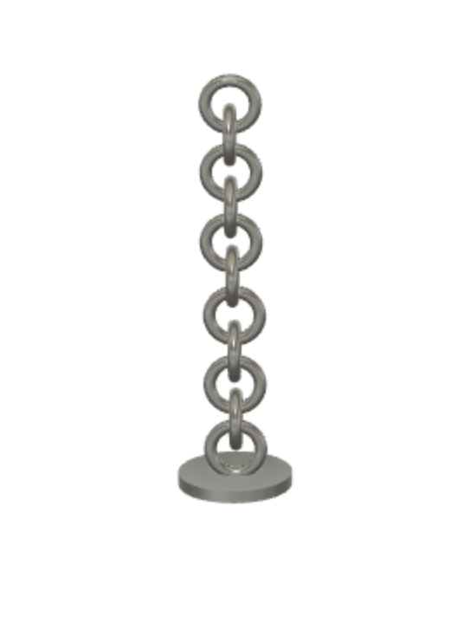
Anchor
An anchor is a nautical captive mobile whose construction characteristics allow a boat or buoys to fix their position in the sea without having to worry about the current, opposing the strength of the tide.
The anchoring anchor usually consists of two or more hooks that are responsible for this clinging to the seabed, preventing the ship from being drifted.

Slide 12
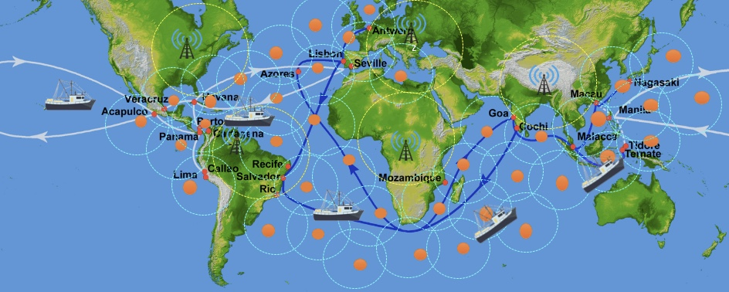
Scheme Wi-Ocean-Max

Slide 13
PLANS IN THE FUTURE
To connect the world through a wireless network in an easy and much cheaper way than any of the methods already used in the market.
Since creating a wide coverage area in the ocean has been a challenge until now, it has been difficult to transfer data in the systems used to monitor the climatic conditions in your environment, now thanks to Wi-ocean-max it will be easier the transfer of data since its extensive transmission system will help to obtain each one from the ocean to the ground control center.
Create a control system (Elite) where through an app (SCE) the routes of the ships will be registered on a daily and efficient way, in order to mobilize the wi-ocean-max automatically and that thanks to this way they are rearranged in a strategic way where they can cover the area without coverage, that means, that the user when planning their trip, the application will automatically save the route and the wi-ocean-max will be deployed assuming a position that favors the Travel coverage since each device has a perimeter and all together will create a coverage mesh where it will be difficult for the connection to be lost or weakened in such a way.

